Slide 1
RECITATION 9: Recommender Systems
15.774/780 (Fall 2021)

Slide 2
Announcements
Project proposal feedback will be given to you early next week
Remaining assignments:
HW4 – Collaborative Filtering due 11/19
Case Study - Vungle due 11/22
Case Study - Auctions due 11/24
HW5 - Bandits due 11/29
Final Project Report due 12/8
Notes:
Write formulas on the board before class

Slide 3
Agenda
Content-Based Filtering
Collaborative Filtering
User based
Item based
Overview of each method
Recommender Systems in reality
Collaborating filtering in R
Notes:
Write formulas on the board before class

Slide 4
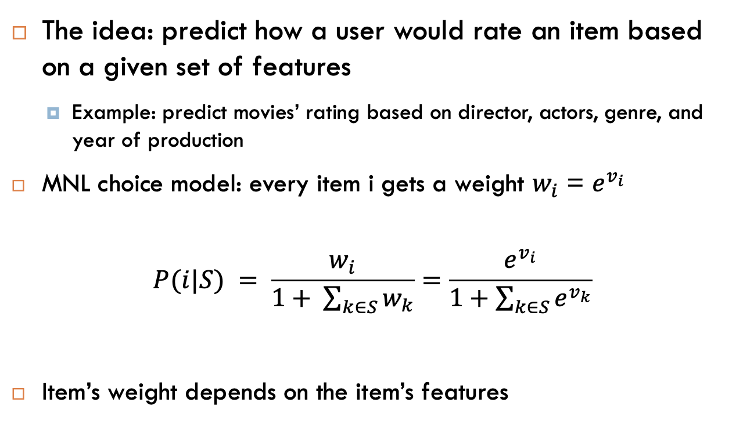
Content/Feature Based Filtering
The idea: predict how a user would rate an item based on a given set of features
Example: predict movies’ rating based on director, actors, genre, and year of production
MNL choice model: every item i gets a weight $w_{i}$ = $e^{v_{i}}$
$$P(i|S) = \frac{w_{i}}{1+ \sum_{k∈S}{w_{k}}}=\frac{e^{v_{i}}}{1+\sum_{k∈S}{e^{v_{k}}}}$$
Item’s weight depends on the item’s features
Notes:
Write formulas on the board before class

Slide 5

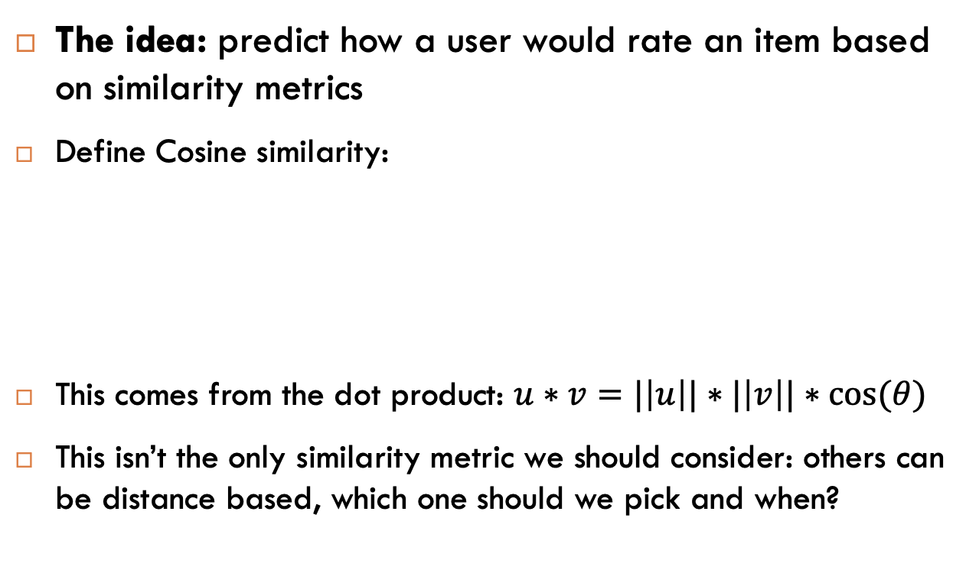
Collaborative Filtering
The idea: predict how a user would rate an item based on similarity metrics
Define Cosine similarity:
This comes from the dot product: $u∗v=|\left|u\right||∗|\left|v\right||∗cos⁡(θ)$
This isn’t the only similarity metric we should consider: others can be distance based, which one should we pick and when?
Notes:
Write formulas on the board before class

Slide 6
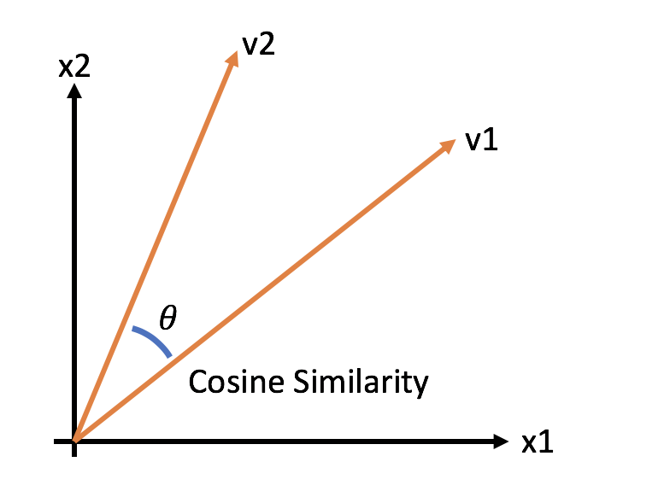

Collaborative Filtering
Illustration in 2D:
Let’s try an example:
$\left[\begin{matrix}1 & 4 & 5 \\ 2 & 3 & 1 \\ 1 & 4 & 4\end{matrix}\right]$-> $s_{12}=$
$$s_{12}= \frac{\left(1\right)\left(2\right)+\left(4\right)\left(3\right)+(5)(1)}{\sqrt{\left(1^{2}+4^{2}+5^{2}\right)∗(2^{2}+3^{2}+1^{2})}}= \frac{24}{588}=0.04$$
Notes:
Write formulas on the board before class

Slide 7
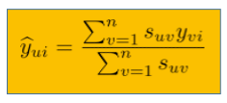
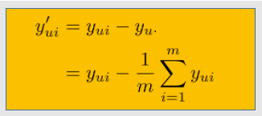
User Based Collaborative Filtering
The idea: predict how a user would rate an item based on how similar users rated this item
Algorithm from lecture:
Correct for user bias: subtract each entry by its user’s mean rating
Calculate bias adjusted similarity matrix (treat negatives as zero)
Make a user-based prediction
Add user’s mean to get an adjusted prediction
In short:
Notes:
Write formulas on the board before class

Slide 8
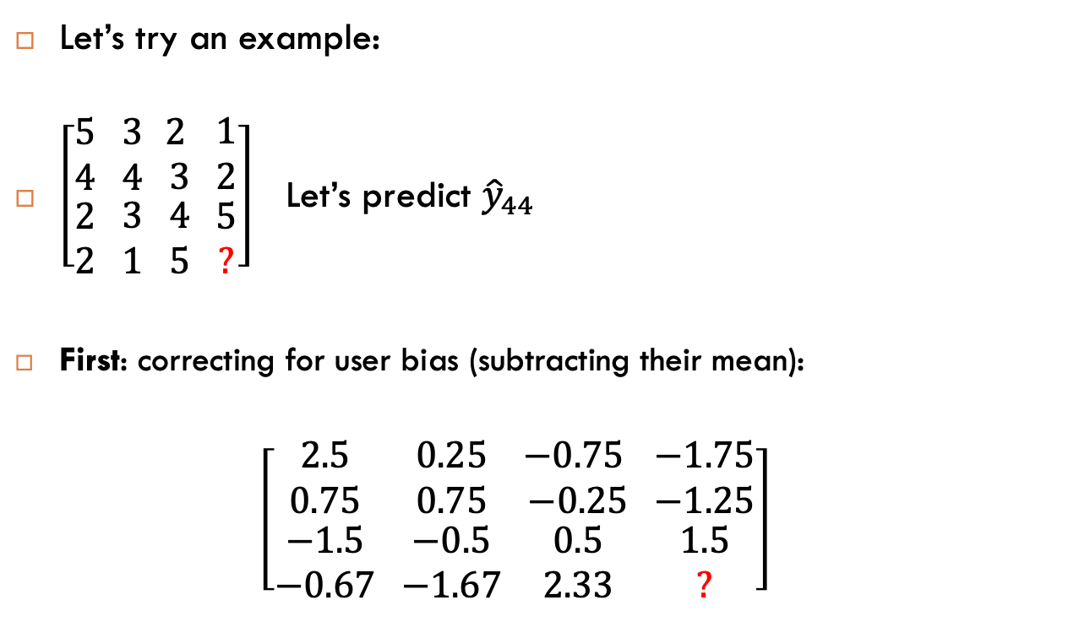
User Based Collaborative Filtering
Let’s try an example:
$\left[\begin{matrix}5 \\ 4 \\ \begin{matrix}2 \\ 2\end{matrix}\end{matrix}\begin{matrix} 3 \\ 4 \\ \begin{matrix} 3 \\ 1\end{matrix}\end{matrix}\begin{matrix} 2 \\ 3 \\ \begin{matrix} 4 \\ 5\end{matrix}\end{matrix}\begin{matrix} 1 \\ 2 \\ \begin{matrix} 5 \\ ?\end{matrix}\end{matrix}\right]$ Let’s predict ${\hat{y}}_{44}$
First: correcting for user bias (subtracting their mean):
$$\left[\begin{matrix}2.5 \\ 0.75 \\ \begin{matrix}−1.5 \\ −0.67\end{matrix}\end{matrix}\begin{matrix} 0.25 \\ 0.75 \\ \begin{matrix} −0.5 \\ −1.67\end{matrix}\end{matrix}\begin{matrix} −0.75 \\ −0.25 \\ \begin{matrix} 0.5 \\ 2.33\end{matrix}\end{matrix}\begin{matrix} −1.75 \\ −1.25 \\ \begin{matrix} 1.5 \\ ?\end{matrix}\end{matrix}\right]$$
Notes:
Write formulas on the board before class

Slide 9
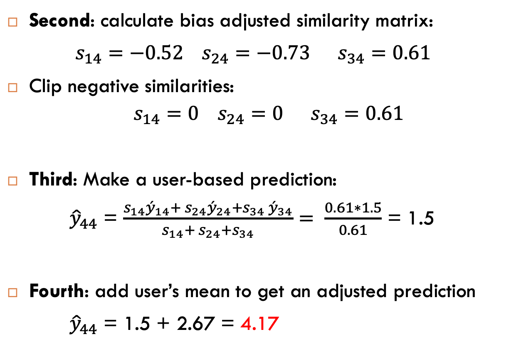
User Based Collaborative Filtering
Second: calculate bias adjusted similarity matrix:
$s_{14}=−0.52 { s}_{24}=−0.73{ s}_{34}=0.61$
Clip negative similarities:
$$s_{14}=0 { s}_{24}=0{ s}_{34}=0.61$$
Third: Make a user-based prediction:
${\hat{y}}_{44}$ = $\frac{s_{14}{\acute{y}}_{14}+ s_{24}{\acute{y}}_{24}+{s_{34} \acute{y}}_{34}}{s_{14}+ s_{24}+s_{34}}= \frac{0.61∗1.5}{0.61}$ = 1.5
Fourth: add user’s mean to get an adjusted prediction
${\hat{y}}_{44}$ = 1.5 + 2.67 = 4.17
Notes:
Write formulas on the board before class

Slide 10
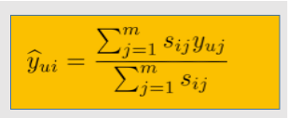
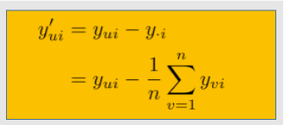
Item Based Collaborative Filtering
The idea: predict how an item will be predicted by a user based on how similar items are ranked
Algorithm: (identical to user-based, but now considering items (columns) and not users (rows)
Correct for ‘item bias’: subtract each entry by its item’s mean rating
Calculate item bias adjusted similarity matrix (treat negatives as zero)
Make an item-based prediction
Add item’s mean to get an adjusted prediction
In short:
Notes:
Write formulas on the board before class

Slide 11
Overview-Content Based
Content/Feature based filtering
Pros:
Can be applied to totally new items
Low (ish) model complexity (~#features)
Cons:
We need to come up with features (domain knowledge)
Requires a decent amount of information about the items
Not straightforwardly applied to new users
Cannot extrapolate!
Notes:
Write formulas on the board before class

Slide 12
Overview-Collaborative
Collaborative based filtering
Pros:
No need of features (domain knowledge)
Does not need any information about items/users but the rating a user gave to an item
Works well with many users (by definition)
Can recommend new items!
Cons:
Cannot be applied to totally new items or users (Cold start problem)
Deals with very large matrices
Hard to include side features for items (other features that can greatly affect our predictions)
Notes:
Write formulas on the board before class

Slide 13
In Reality
In reality, the dimensionality of the user-item matrices are extremely high (think of hundreds of millions, squared!)
Dimensionality reduction techniques reduce complexity dramatically (rank k approximation, SVD, PCA)
Check out SGD for Matrix Factorization!
Many other ways you can explore: Memory based, Clustering, Matrix Factorization, Deep Factorization Machines, Neural Factorization Machines, etc.
Python implementations: Surprise package (scikit), fast.ai, etc.
Notes:
Write formulas on the board before class

Slide 14
Recommender Systems in R
TO R!
Notes:
Write formulas on the board before class

